Slide 1
Capstone Project
Hotel Booking Analysis
KAMATAM HARSHITH
LAKSHMI KEERTHANA
TITO VARGHESE
ANMOL RAJ

Slide 2
Agenda
Data summary
Data wrangling
Hotel wise analysis
Distribution Channel wise analysis
Cancellation related analysis
Time and Stay related analysis
Conclusion
Points to Discuss

Slide 3
Agenda
To extract,observe and analyse the given hotel bookings data set from 2015-2017.
The analysis of given data set in following ways :
Univariate analysis
Hotel wise analysis
Distribution Channel wise analysis
Booking cancellation analysis
Timewise analysis
Conclusion

Slide 4
Data Summary
Given data set has different columns of variables crucial for hotel bookings:
hotel: The category of hotels, which are two resort hotel and city hotel.
is_cancelled : The value of column show the cancellation type. If the booking was cancelled or not. Values[0,1], where 0 indicates not cancelled.
lead_time : The time between reservation and actual arrival .
stayed_in_weekend_nights: The number of weekend nights stay per reservation
stayed_in_weekday_nights: The number of weekday nights stay per reservation.
meal: Meal preferences per reservation.[BB,FB,HB,SC,Undefined]
Country: The origin country of guest.
market_segment: This column show how reservation was made and what is the purpose of reservation. Eg, corporate means corporate trip, TA for travel agency.
distribution_channel: The medium through booking was made. [Direct,Corporate,TA/TO,undefined,GDS.]
Is_repeated_guest: Shows if the guest is who has arrived earlier or not.Values[0,1]-->0 indicates no and 1 indicated yes person is repeated guest.
days_in_waiting_list: Number of days between actual booking and transact.
customer_type: Type of customers( Transient, group, etc.)

Slide 5
Data information
# Column Non-Null Count Dtype
--- ------ -------------- -----
0 hotel 119390 non-null object
1 is_canceled 119390 non-null int64
2 lead_time 119390 non-null int64
3 arrival_date_year 119390 non-null int64
4 arrival_date_month 119390 non-null object
5 arrival_date_week_number 119390 non-null int64
6 arrival_date_day_of_month 119390 non-null int64
7 stays_in_weekend_nights 119390 non-null int64
8 stays_in_week_nights 119390 non-null int64
9 adults 119390 non-null int64
10 children 119386 non-null float64
11 babies 119390 non-null int64
12 meal 119390 non-null object
13 country 118902 non-null object
14 market_segment 119390 non-null object
15 distribution_channel 119390 non-null object
16 is_repeated_guest 119390 non-null int64
17 previous_cancellations 119390 non-null int64
18 previous_bookings_not_canceled 119390 non-null int64
19 reserved_room_type 119390 non-null object
20 assigned_room_type 119390 non-null object
21 booking_changes 119390 non-null int64
22 deposit_type 119390 non-null object
23 agent 103050 non-null float64
24 company 6797 non-null float64
25 days_in_waiting_list 119390 non-null int64
26 customer_type 119390 non-null object
27 adr 119390 non-null float64
28 required_car_parking_spaces 119390 non-null int64
29 total_of_special_requests 119390 non-null int64
30 reservation_status 119390 non-null object
31 reservation_status_date 119390 non-null object

Slide 6
Data Cleaning
Data Cleaning is a crucial step before EDA as it will remove the ambiguous data that can affect the outcome of EDA.
While cleaning data we will perform the following steps:
1) Remove duplicate rows (df1[df1.duplicated()].shape)+df1.drop_duplicates(inplace = True)
2) Handling missing values.
3) Convert columns to appropriate data types. (df1[['children', 'company', 'agent']] = df1[['children', 'company', 'agent']].astype('int64'))

Slide 7
Hotel wise analysis
Hotel with higher bookings cancellation rate.
Hotel with longest waiting time
Hotel with most revenue.
Chances of customer returning to hotel for another stay
Factors Governing Booking
Special requests by the guests
Distribution Channel wise analysis
Most used Distribution Channel
Which distribution channel brings better revenue generating deals for hotels?
Market segments used by the guests
Distribution Channel with highest cancellation
Cancellation related Analysis
Waiting time(days)
Lead Time
Cancellation for not assigning same room
Car parking space
Time and Stay related Analysis
Customer type with maximum Average Daily Rate
Type of customers booking the most
Heat correlation map Best time to book a hotel room
Board Basis preferred
Countries from which most customers are coming

Slide 8
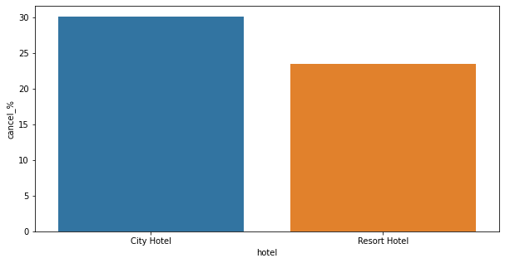
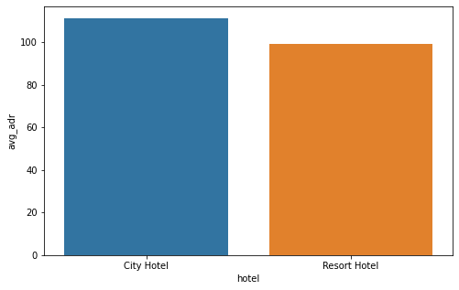
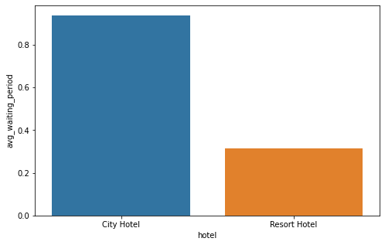
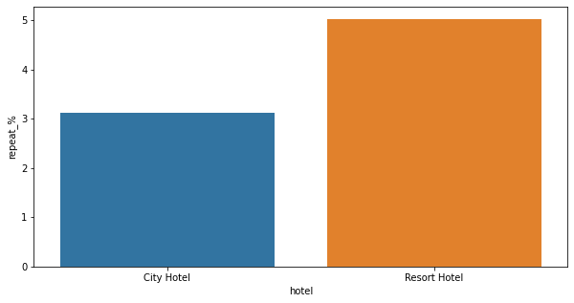
Hotel with higher bookings cancellation rate
Hotel with longest waiting time
Hotel with most revenue
Chances of customer returning to hotel for another stay

Slide 9
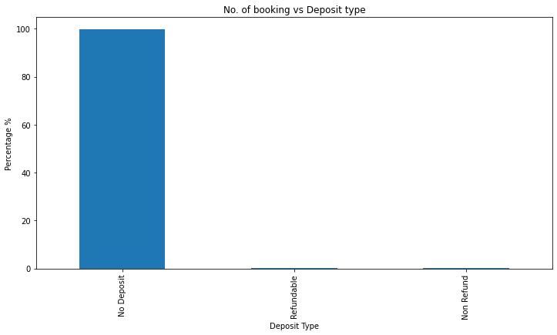
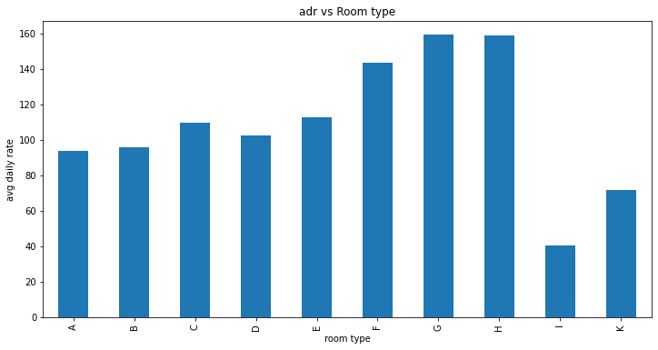
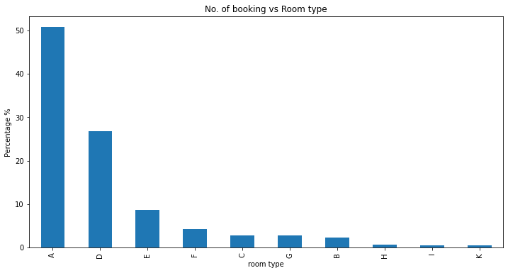
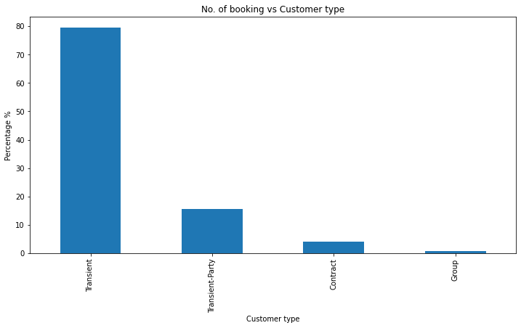
Factors governing booking
Deposit type
Room type assigned
Room Type
Customer Type

Slide 10
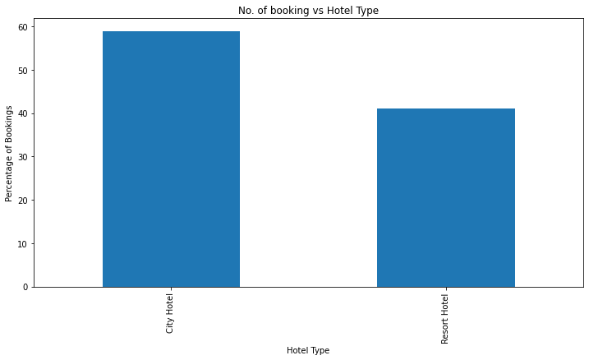
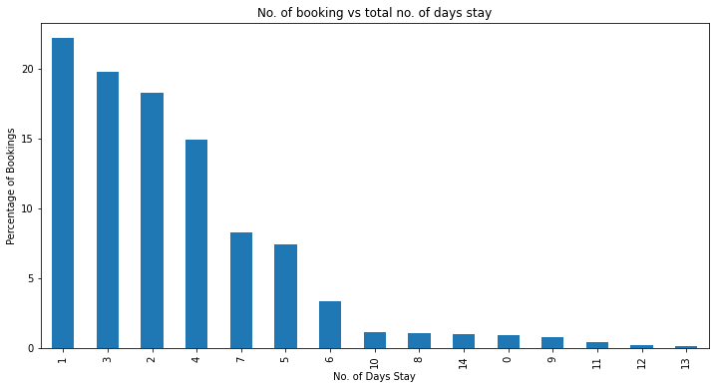
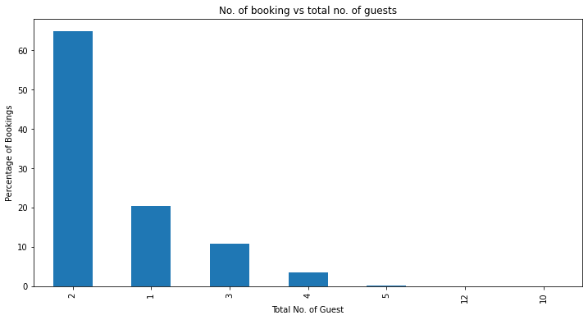
Hotel Type
Total number of days stays
Total Number of Guest

Slide 11
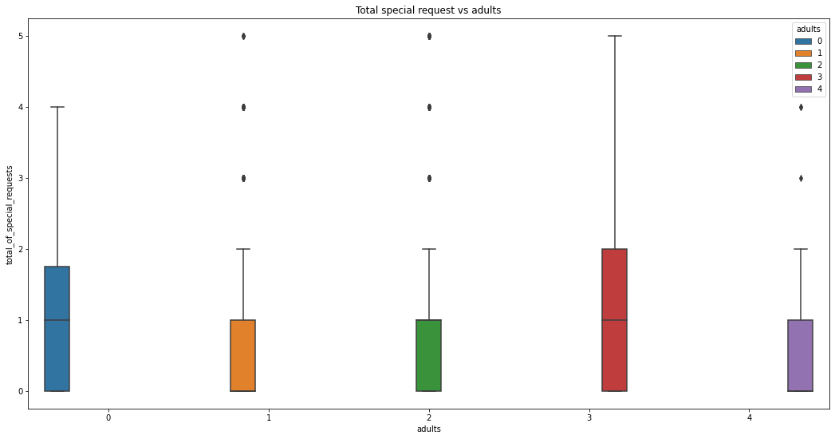
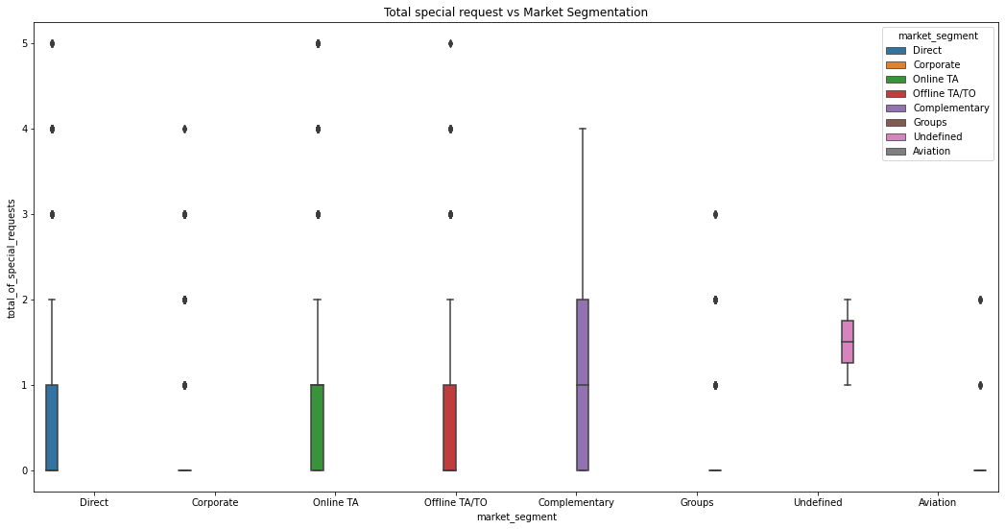
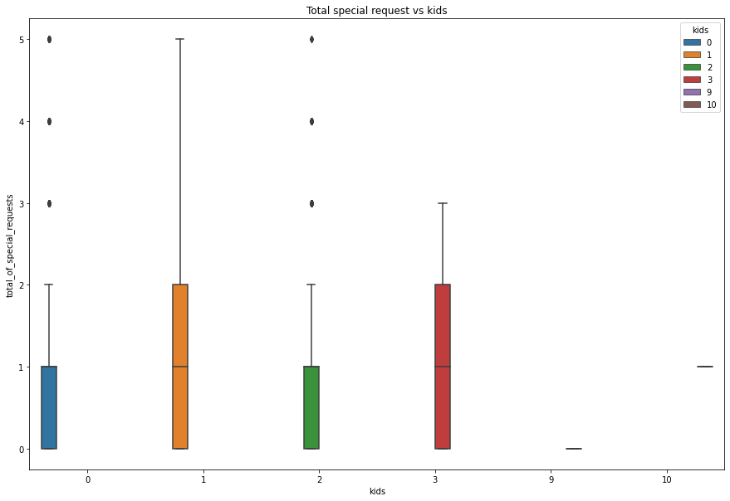
Special requests by the guests
Special Requests According to Adults
Special Requests According to Market Segmentation
Special Requests According to Kids

Slide 12
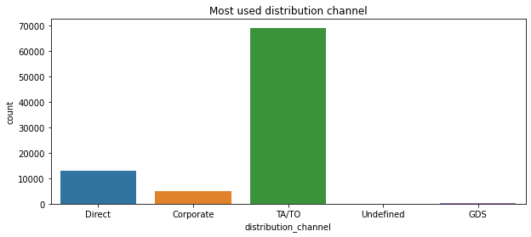
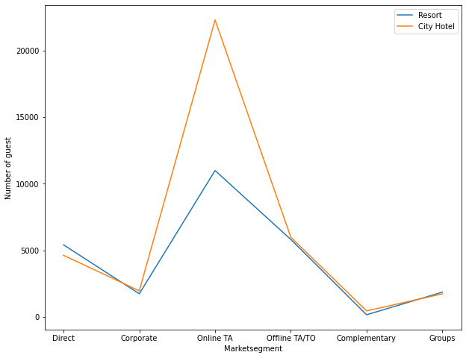
Most used distribution channel
Most used market segment

Slide 13
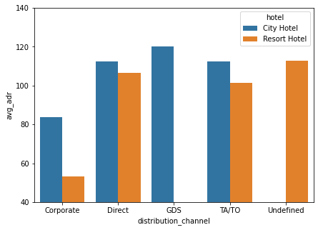
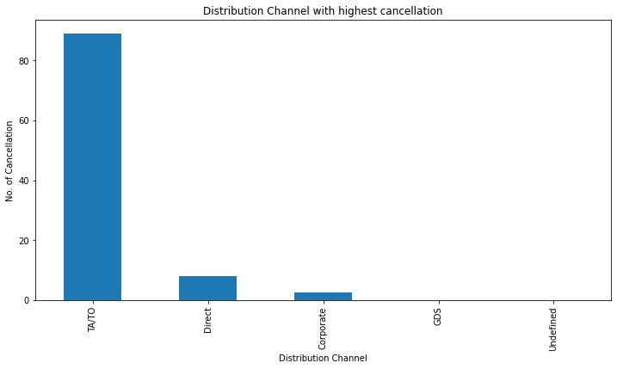
Distribution channel bringing highest revenue
Distribution Channel with highest cancellation

Slide 14
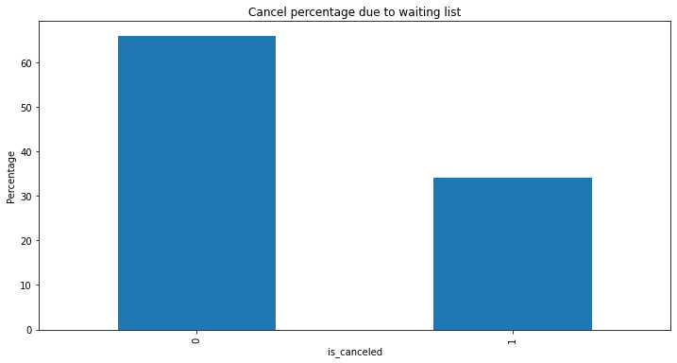
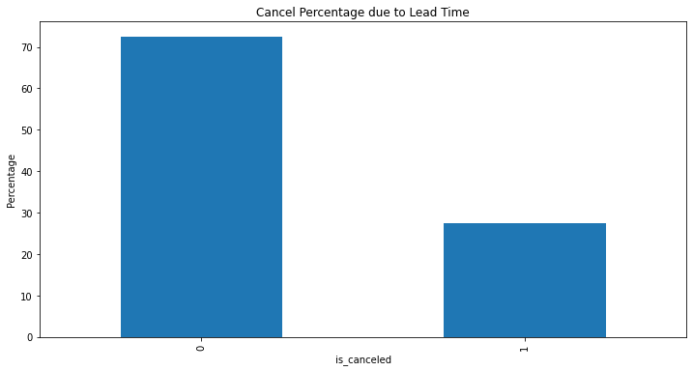
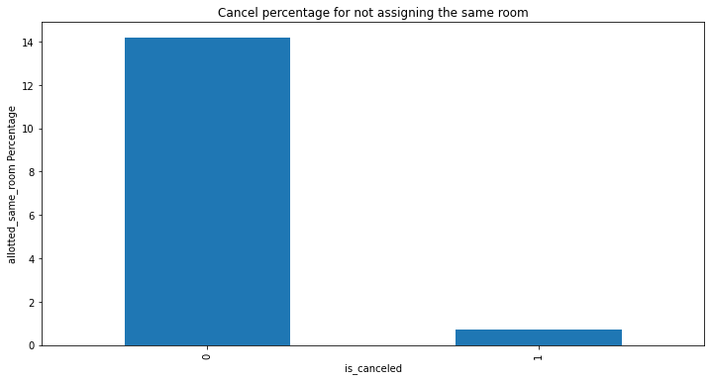
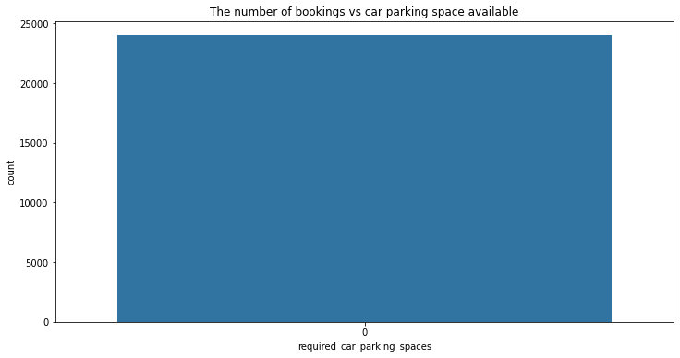
Waiting time(days)
Cancellation related analysis
Lead Time
Cancellation for not assigning same room
Car parking space

Slide 15
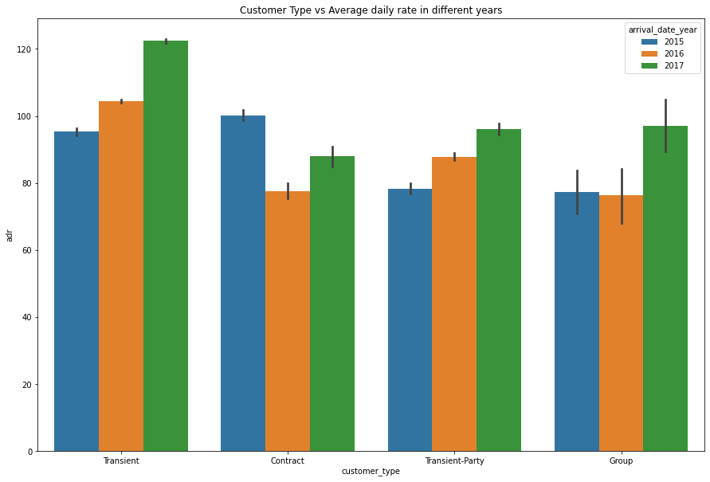
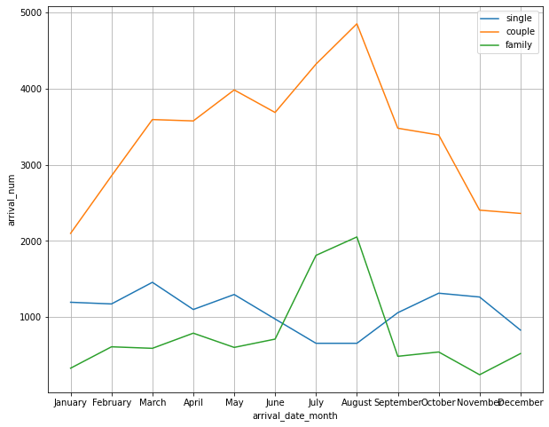
Customer type with maximum Average Daily Rate
Type of customers booking the most

Slide 16
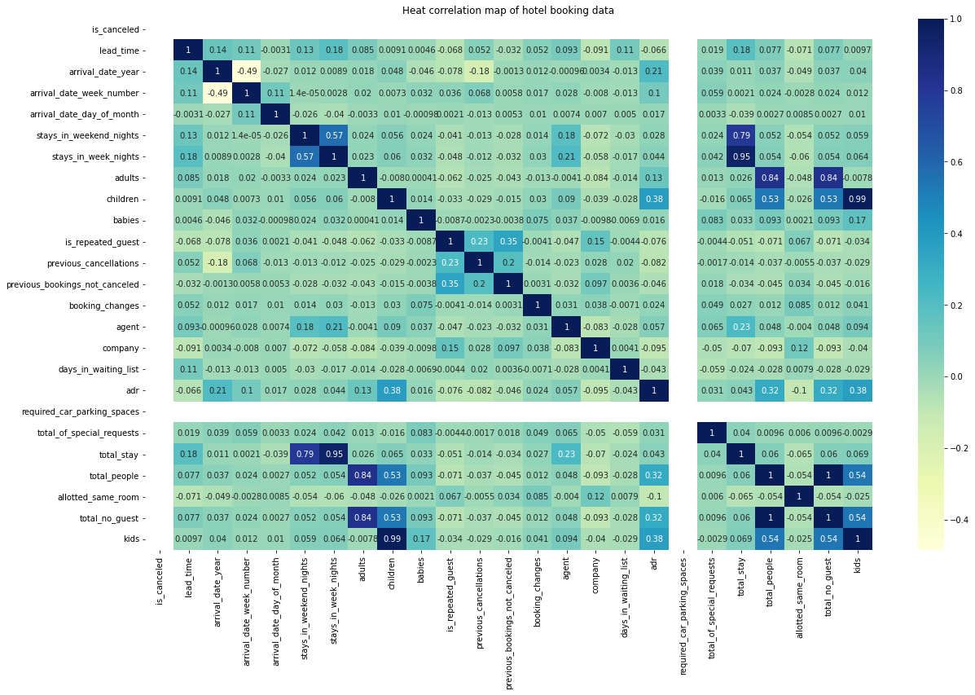
Heat Correlation Map

Slide 17
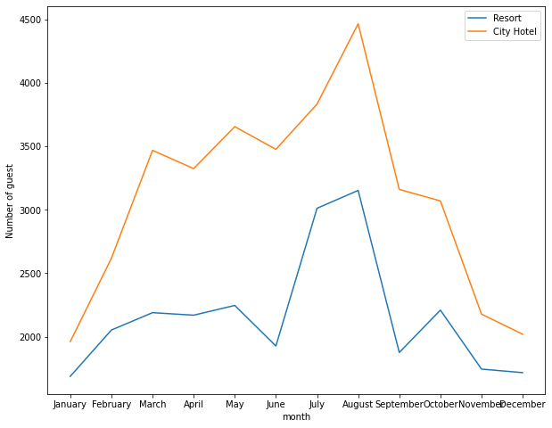
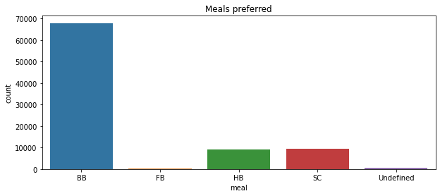
Best time to book a hotel room
Board Basis preferred

Slide 18
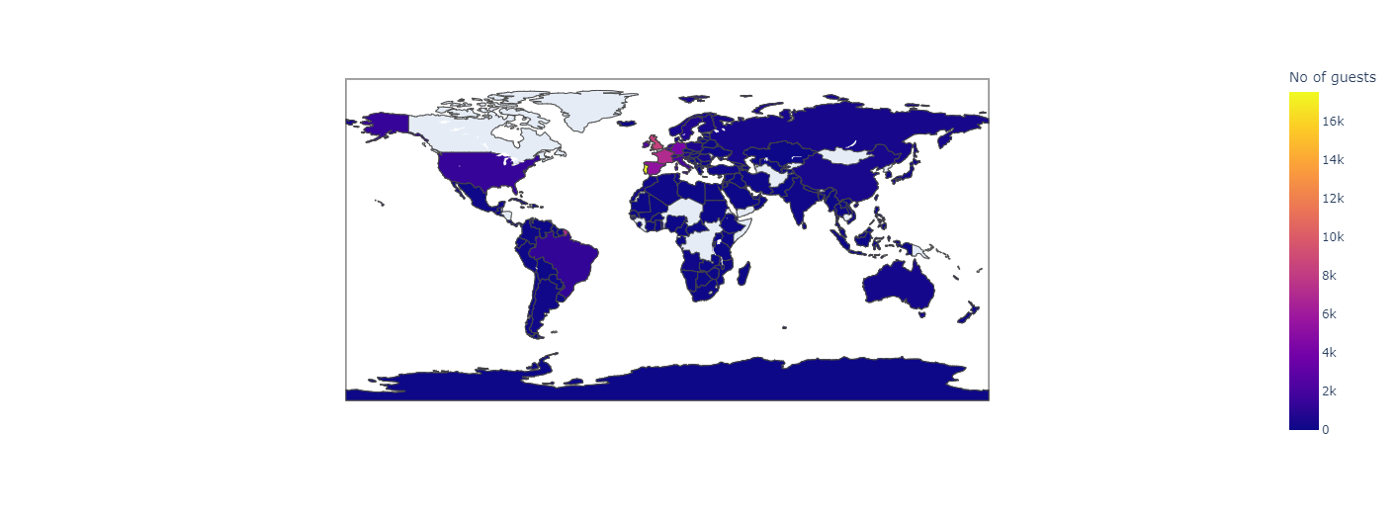
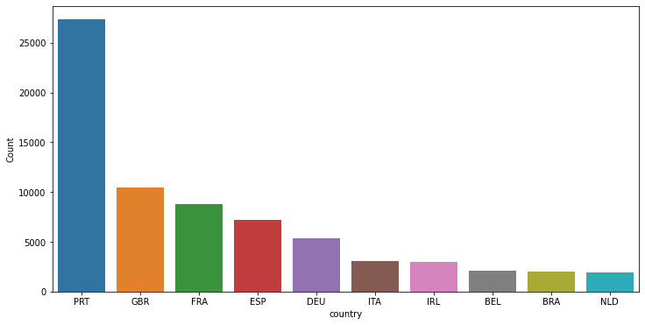
Countries from which most customers are coming
basemap = folium.Map()basemap = folium.Map()
guests_map = px.choropleth(country_wise_guests, locations = country_wise_guests['country'],color = country_wise_guests['No of guests'], hover_name = country_wise_guests['country'])
guests_map.show()
guests_map = px.choropleth(country_wise_guests, locations = country_wise_guests['country'],color = country_wise_guests['No of guests'], hover_name = country_wise_guests['country'])
guests_map.show()

Slide 19
Conclusion
Hotel wise analysis
City hotel generates most revenue.
30% of customers of City Hotel have cancelled their booking.Whereas 5% of customers have cancelled their booking in Resort Hotel.
City Hotel has a higher waiting time than that of Resort Hotel
Room type A has the highest number of bookings compared to the other room types. The most number of bookings was by Transient Customer Type and the least was by Group customer type. Most number of customers used No Deposit option. The number of days stay was mostly 1. Most preferred hotel was City Hotel. Most number of bookings was done by couples.
Both the customers have less chances of its customer returning for the stay.
The most number of special request will be asked from Complementary market segment. And the cases where the number of adults is more than 3 and when there are 1 to 3 number of kids, we can expect for more special requests.
Distribution channel analysis
Most number of customers have used TA/TO(Travel Agency/Travel Operator) distribution channel for hotel booking.
GDS channel brings higher revenue for City hotel. Whereas for Resort hotel gets more revenue by direct and TA/TO channel.
Mostly used market segment by the guests was Online TA to book City hotel and Resort hotel.
Cancellation related analysis
Main reason for cancellation has been because of no car parking space. Waiting period, lead time or assigning of different room has not been a reason for cancellation.

Slide 20
Time and Stay related analysis
We have used seaborn barplot to analyse the best customer type. We can conclude that, transient customer type generates maximum adr. The adr of transient-party has been increasing with the year. The group customer type does not show much of a progression.
Board Basis preferred: In this analysis, we have concluded that the most preferred meal type by the customer is Bed and Breakfast(BB).
As per the plot graph, we can conclude that most of the customers visit in the month of August.
According to the graph, it has been mostly couples or families that has been visiting during the month of July and August.
Most of the guests were from Portugal with 25k customers. Second by Great Britain with 10k customers. Followed by France, Spain and Germany respectively.

